Slide 1
Explainable AI in retail

Slide 2

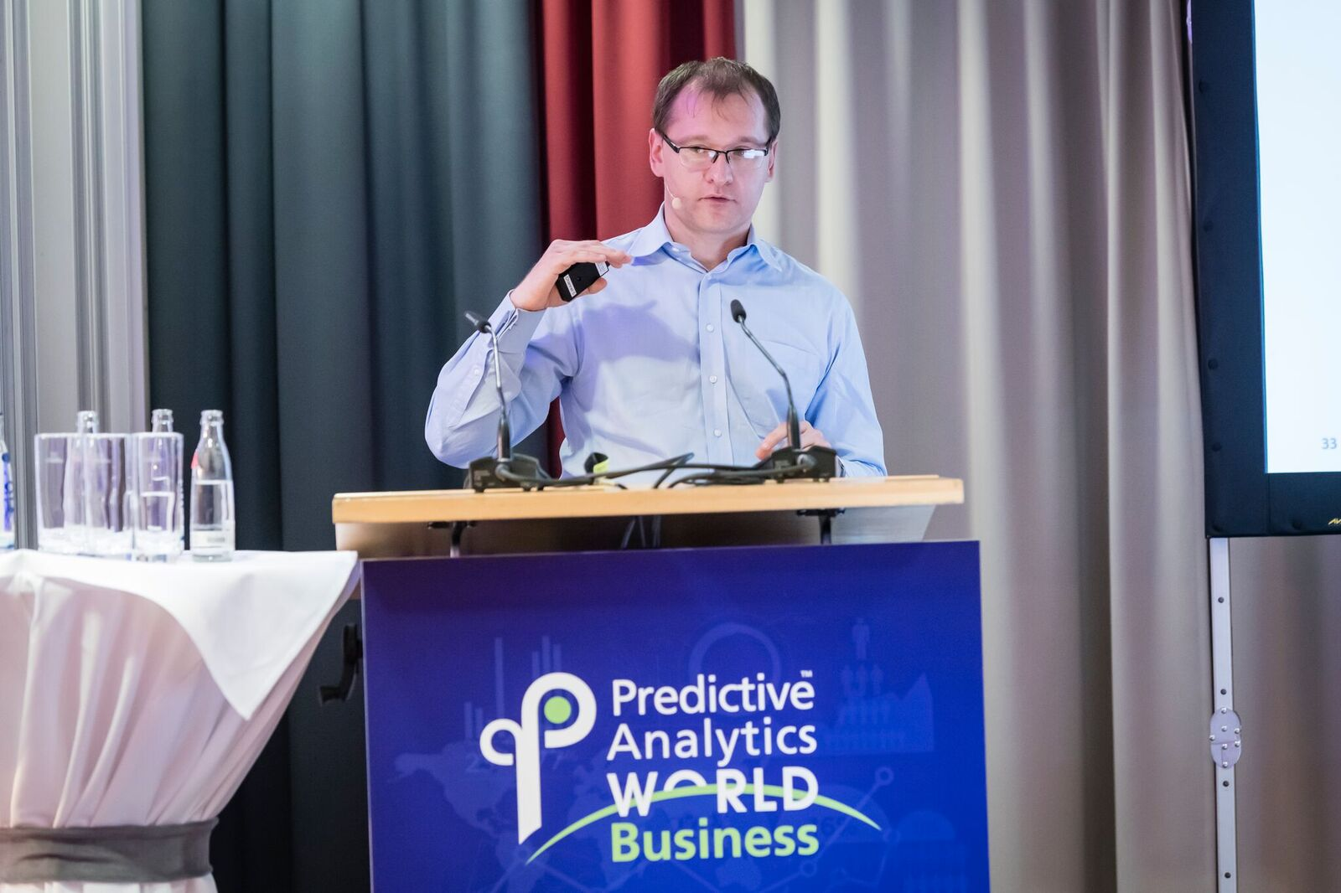
Schwarz group
Company introduction

Slide 3
Agenda
01
What is Explainable AI and why we need it.
02
Emerging approaches.
03
Application to retail use cases.
04
Software and deployment
05
Future prospects.

Slide 4
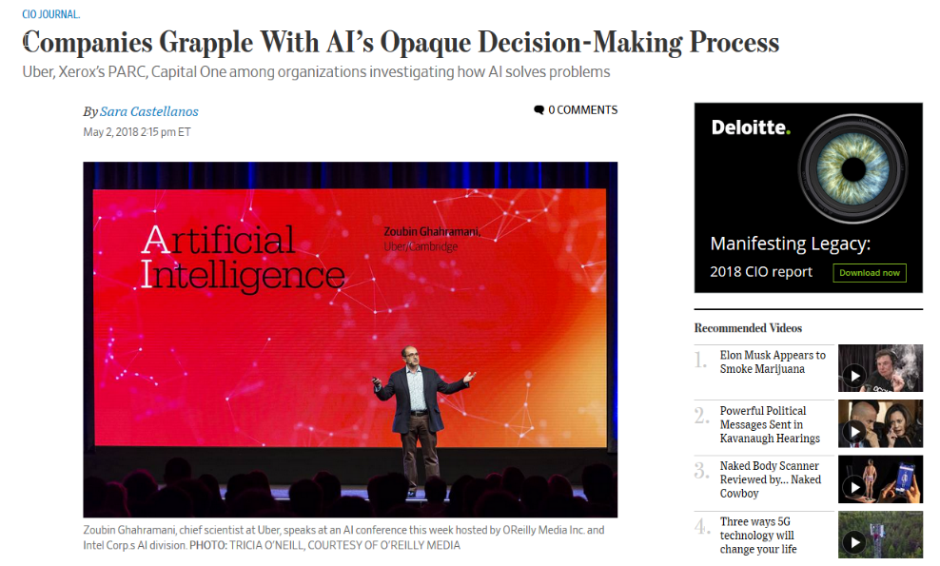
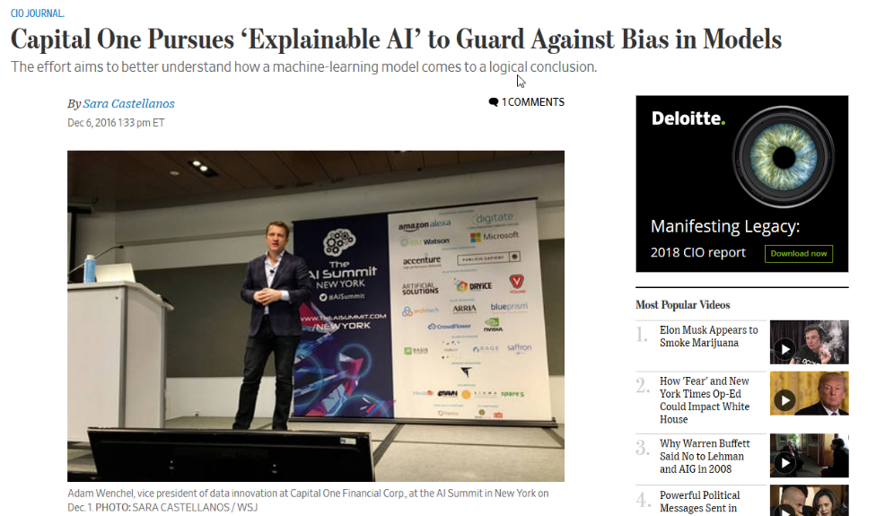
XAI in the media
Introduction

Slide 5
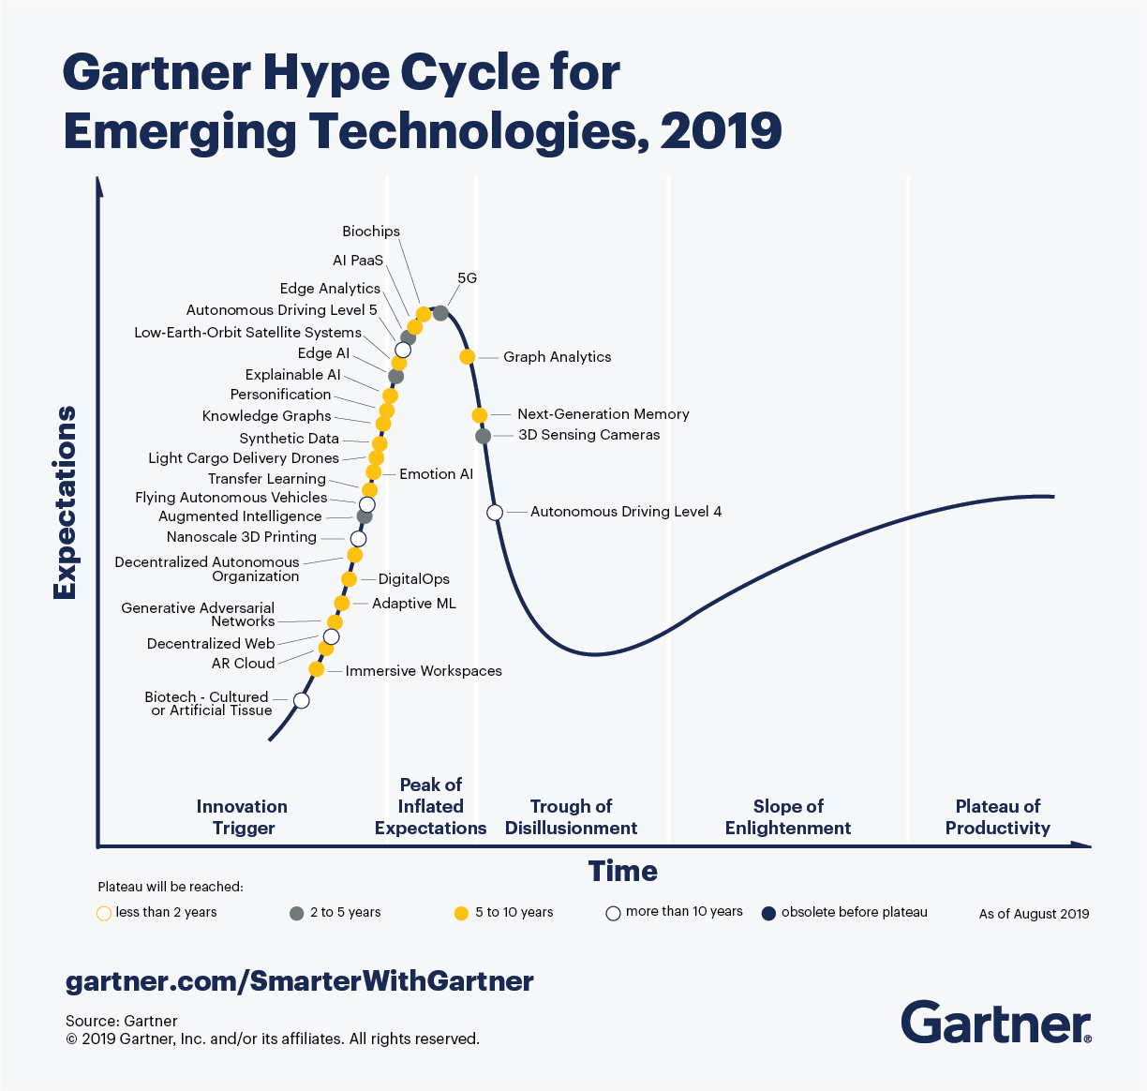
It is a part of hype cycle in 2019
Introduction
https://www.gartner.com/smarterwithgartner/5-trends-appear-on-the-gartner-hype-cycle-for-emerging-technologies-2019/

Slide 6
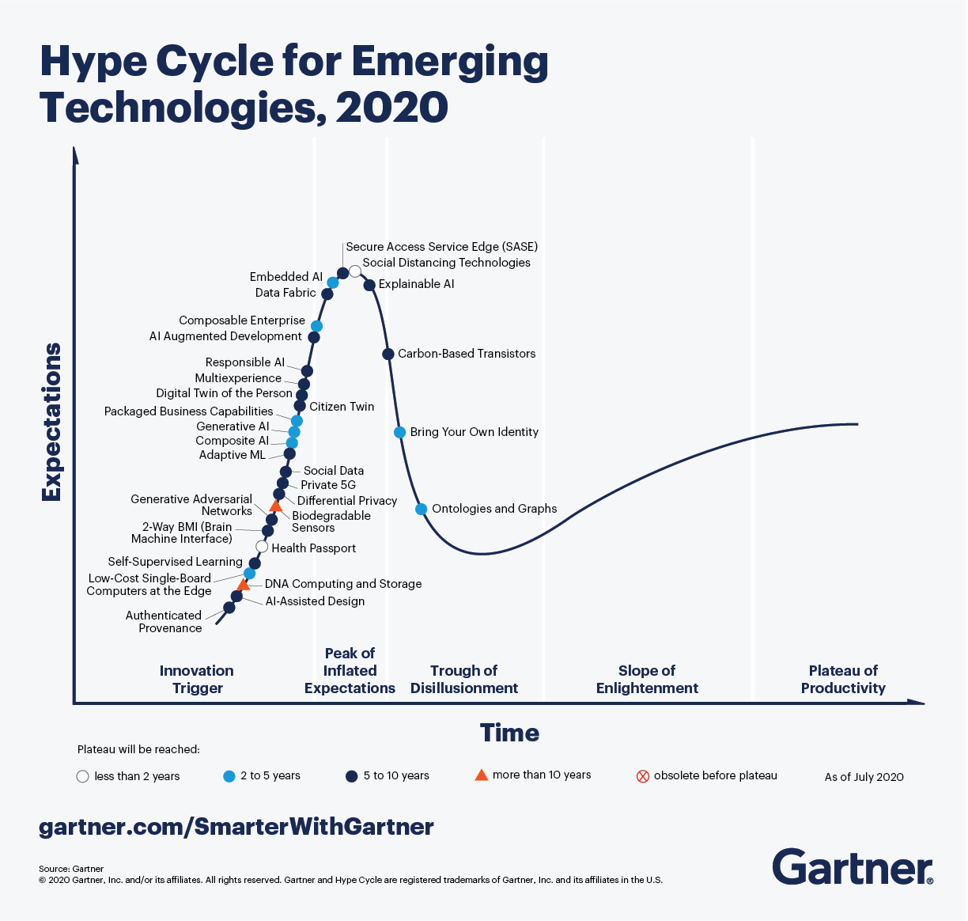
And still in 2020
Introduction
https://www.gartner.com/smarterwithgartner/5-trends-drive-the-gartner-hype-cycle-for-emerging-technologies-2020/

Slide 7
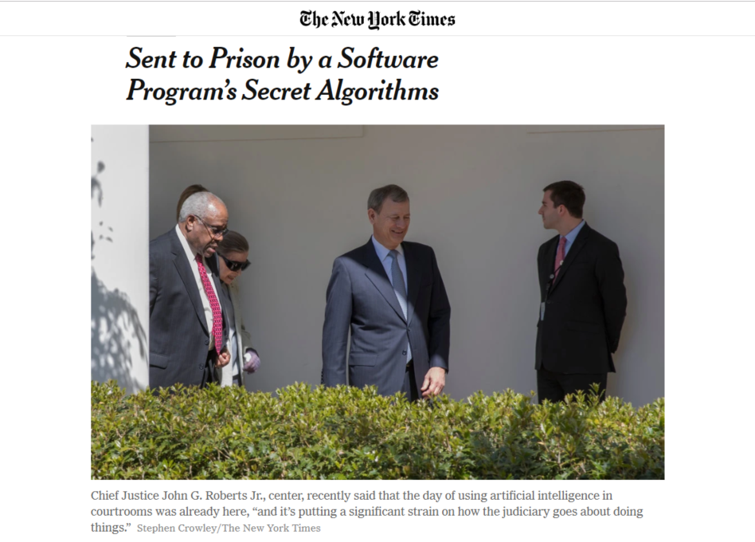

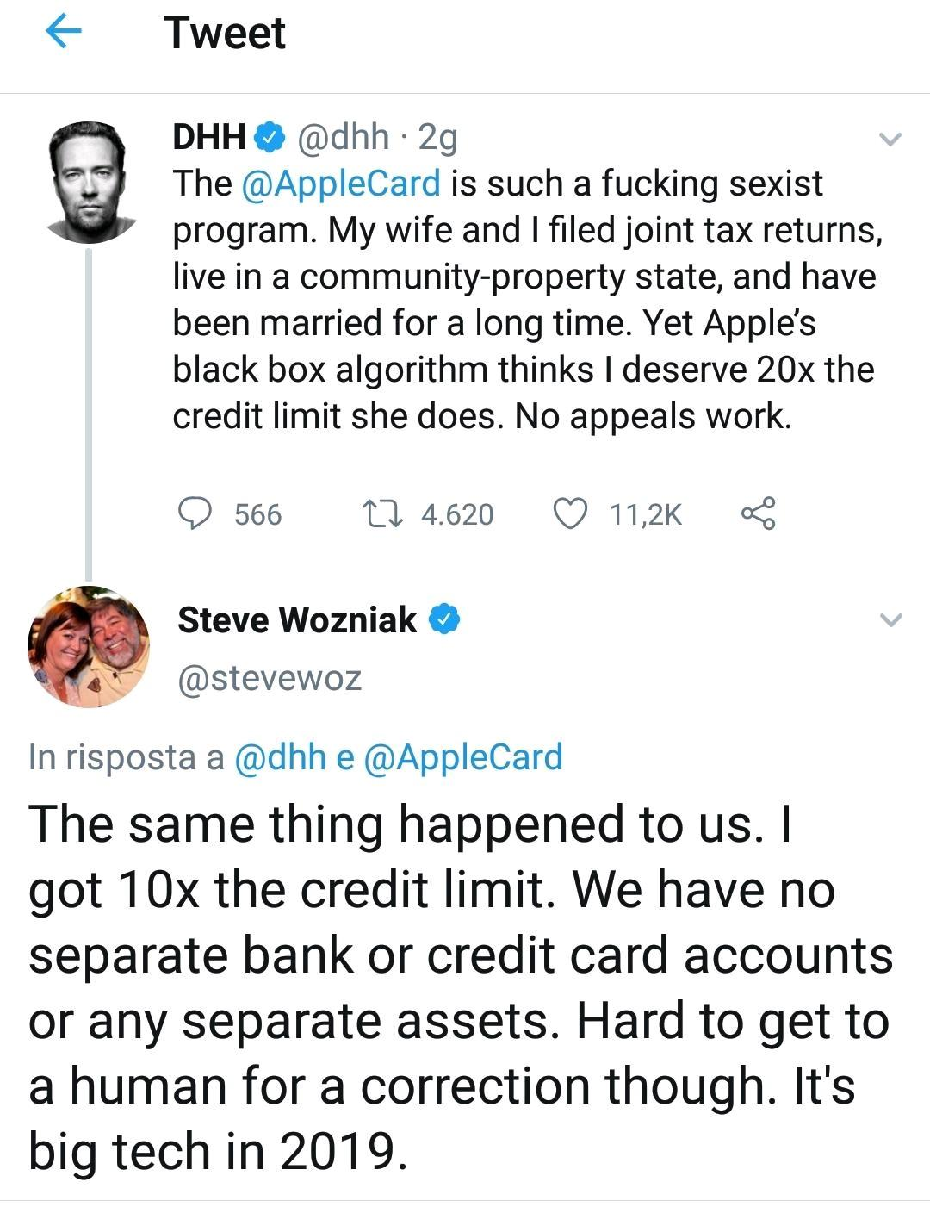
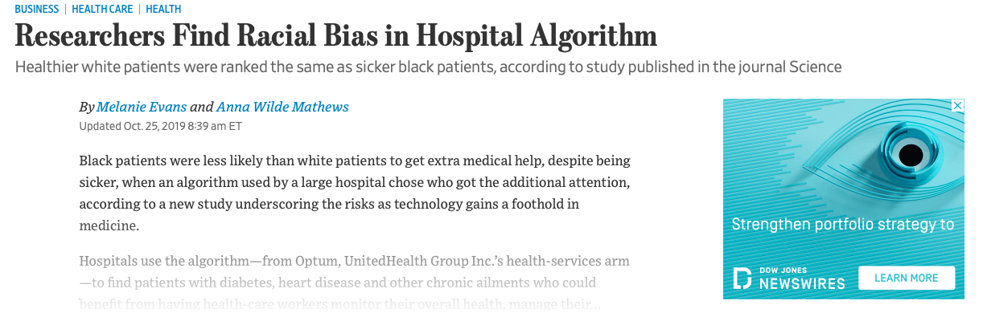
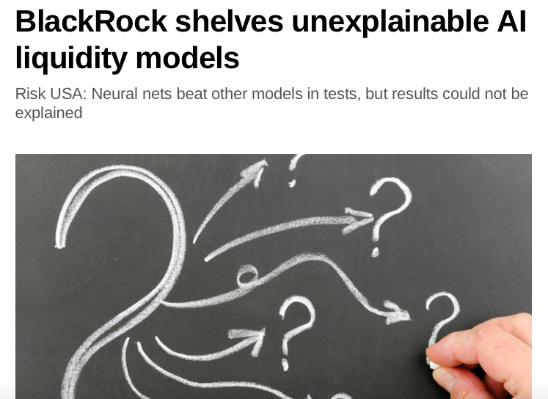
XAI appications
… but not limited to the following areas

Slide 8
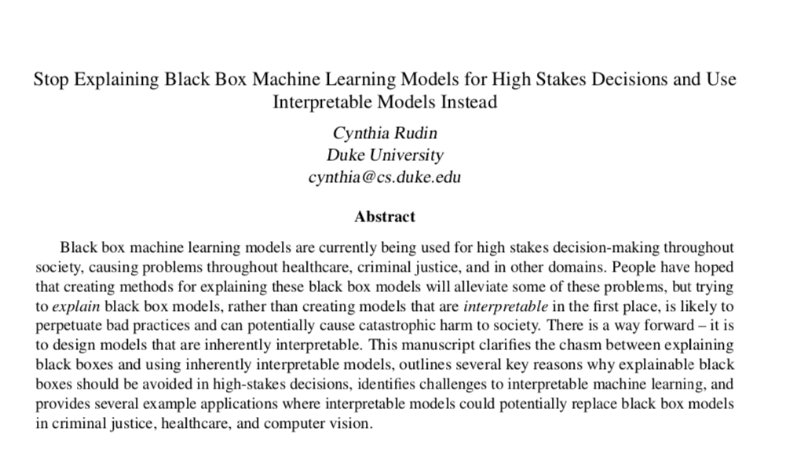
HIGH StAKEs decisions
Introduction

Slide 9
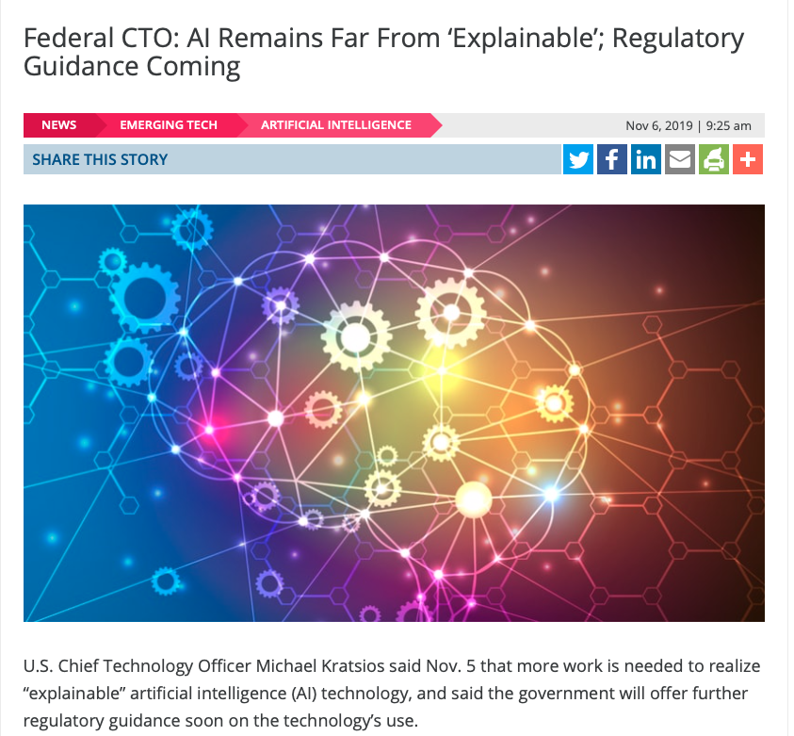
Regulation is coming
Introduction

Slide 10





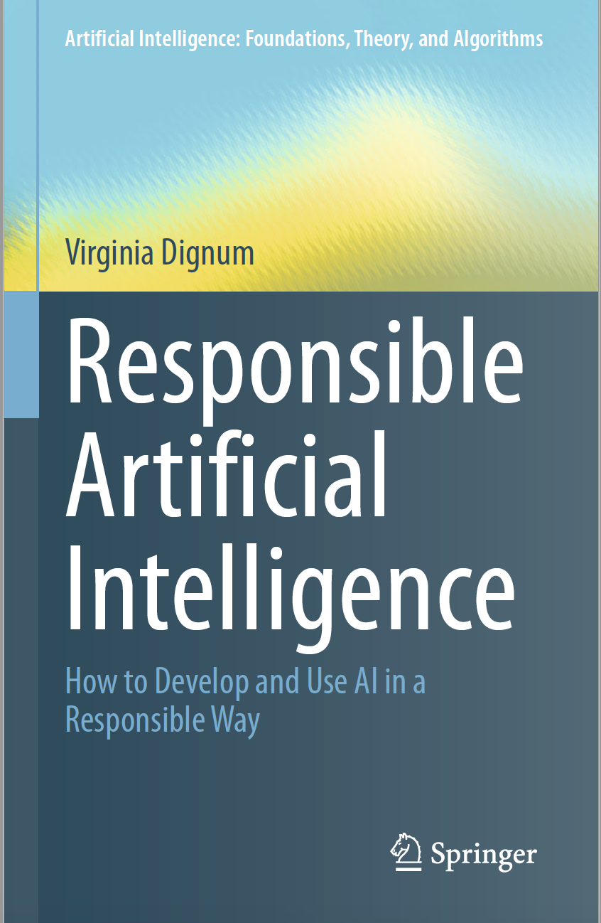
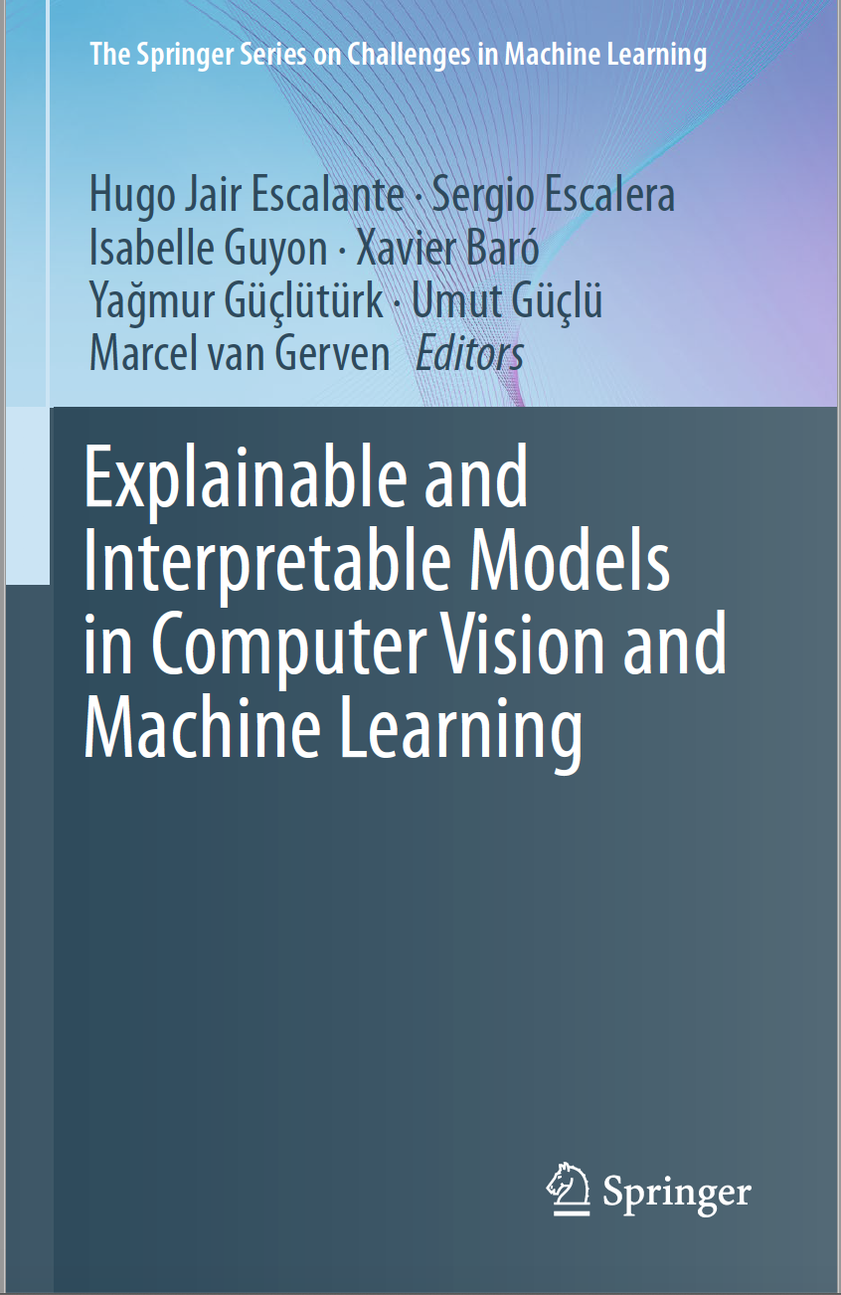


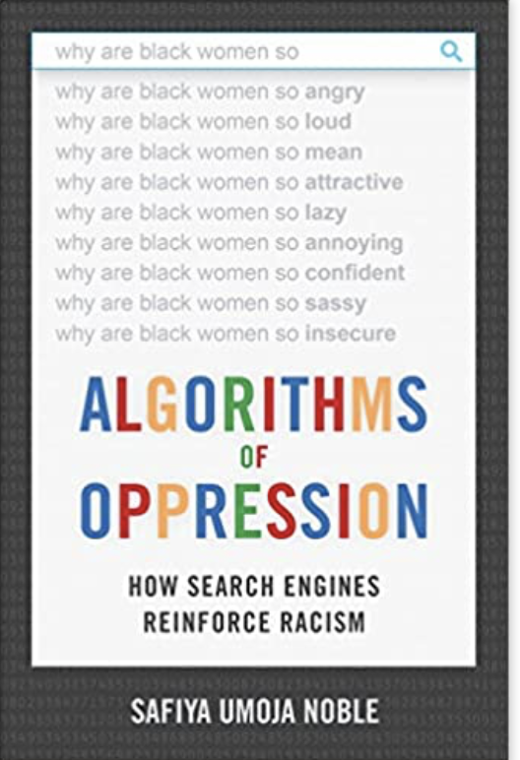


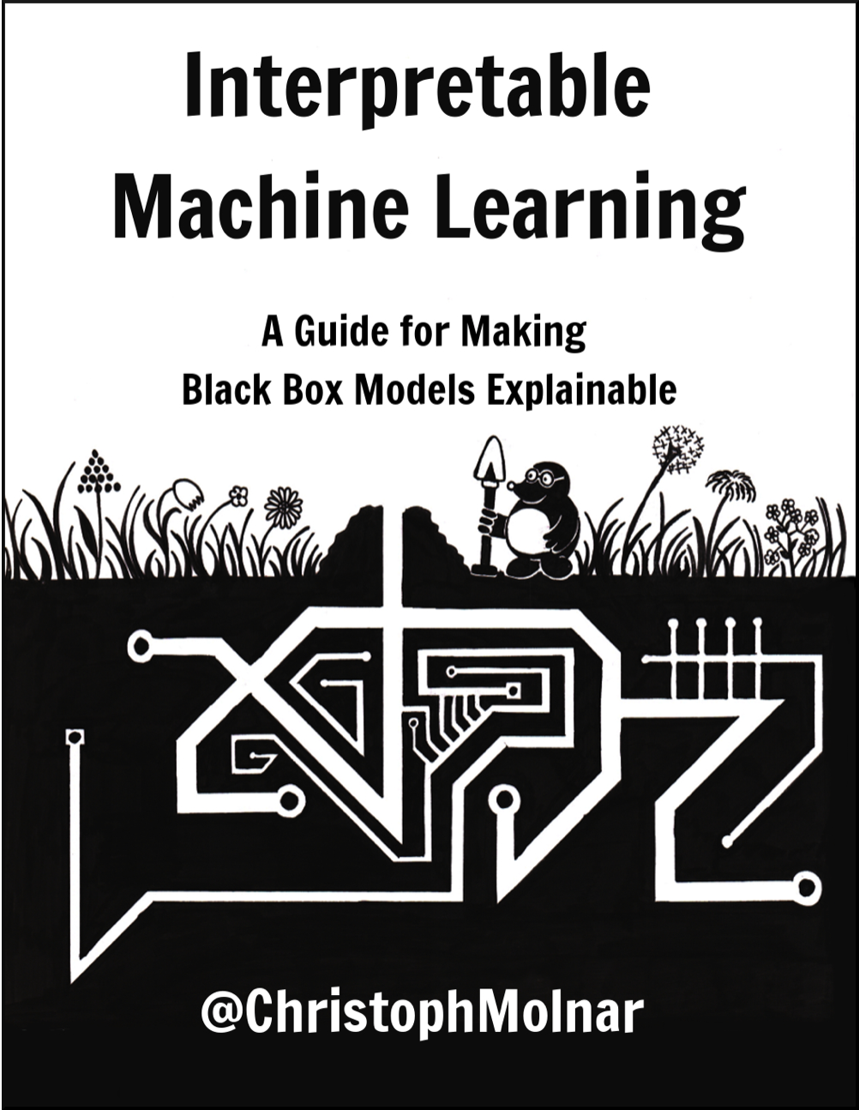
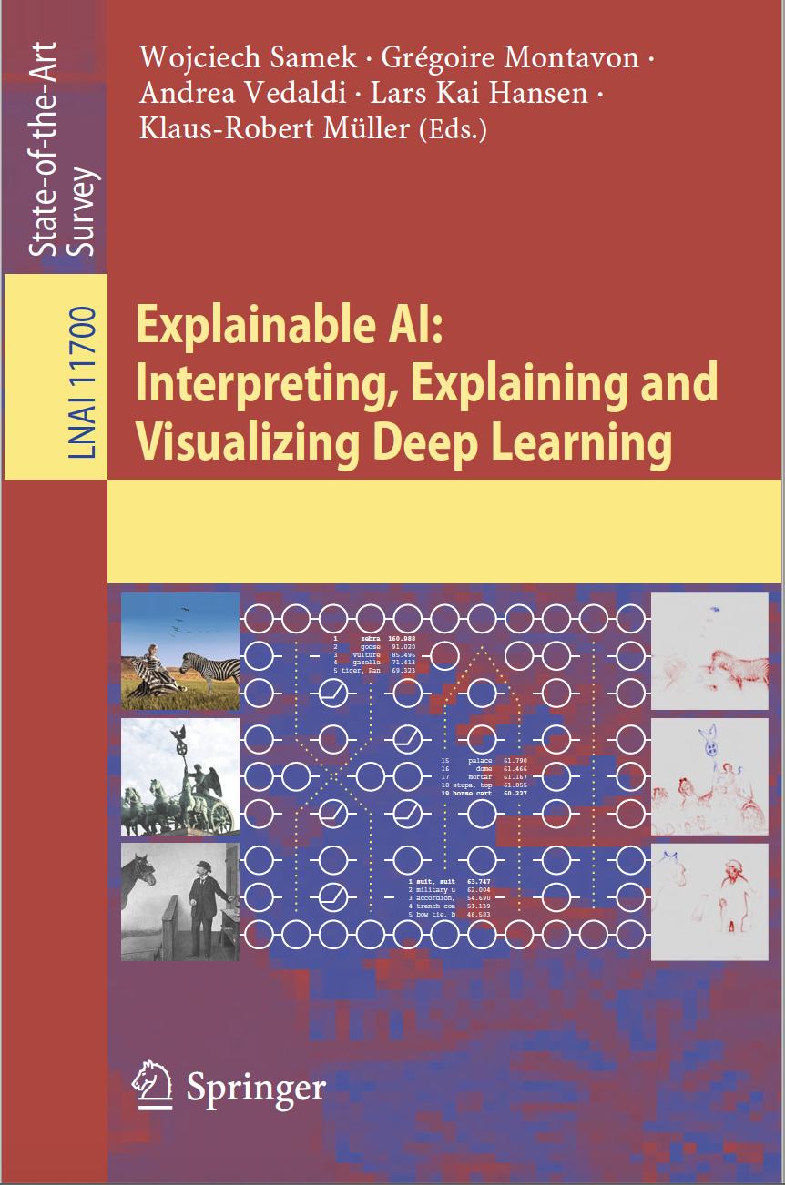
Books
Introduction

Slide 11


























Commercial products
Introduction

Slide 12
XAI is hard
Introduction
Psycology/Social
Technical
Legal

Slide 13
Emerging and existing approaches for tabular data
Emerging approaches
XAI
Glass-box models
Model distillation
Model explanation (global)
Post-hoc model explanations (local)
Linear regression
Logistic regression
Decision trees
Rule list
Rule sets
GAM
Association rules
Bayesian networks
Etc.
Convert a model to decision tree or rules
Model surrogates
Visualisation
Agnostic feature importance
Local surrogate (LIME)
Local feature attribution (SHAP)
Local rule extraction (Anchor, LORE)
Contrastive explanations
Counterfactual explanations
Influence function

Slide 14
Emerging and existing approaches for tabular data
Emerging approaches
XAI
Glass-box models
Model distillation
Model explanation (global)
Post-hoc model explanations (local)
Linear regression
Logistic regression
Decision trees
Rule list
Rule sets
GAM
Association rules
Bayesian networks
Etc.
Convert a model to decision tree or rules
Model surrogates
Visualisation
Agnostic feature importance
Local surrogate (LIME)
Local feature attribution (SHAP)
Local rule extraction (Anchor, LORE)
Contrastive explanations
Counterfactual explanations
Influence function

Slide 15
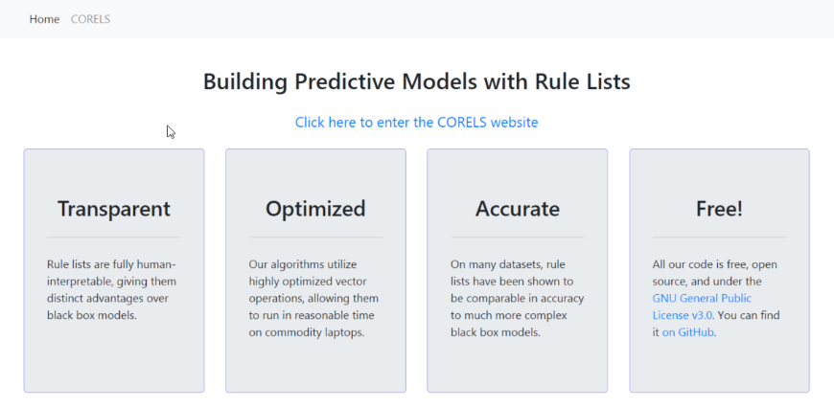
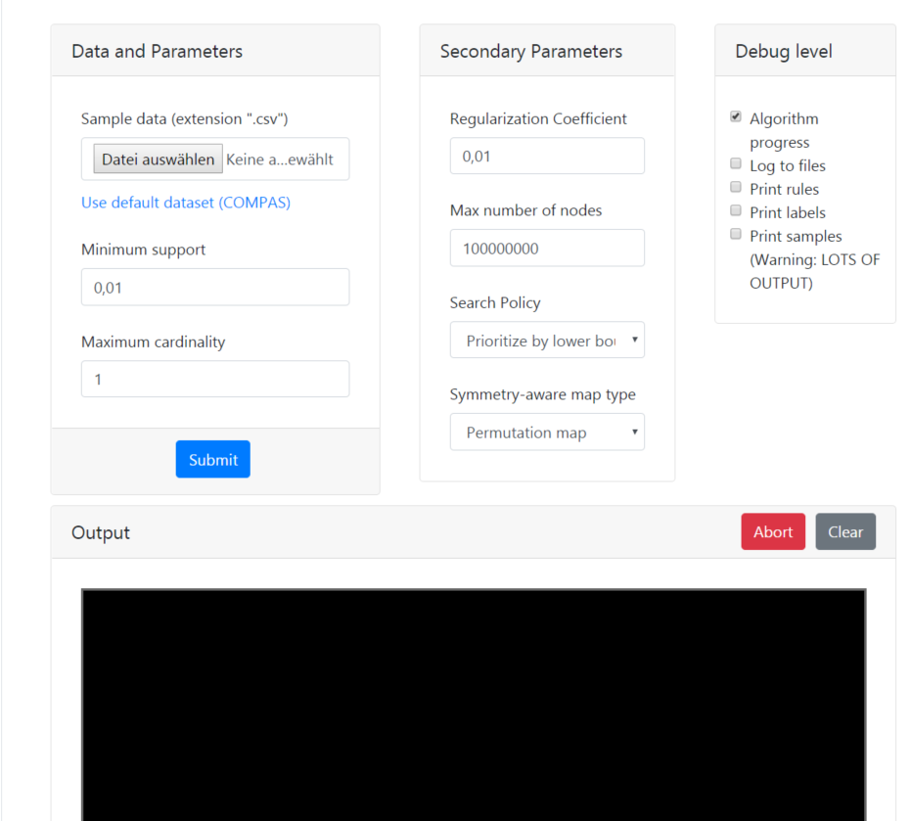

Try CORELS
https://corels.eecs.harvard.edu/corels/run.html

Slide 16
XAI in retail
Application to retail
XAI
Stakeholder management
Build user trust
Model debugging

Slide 17
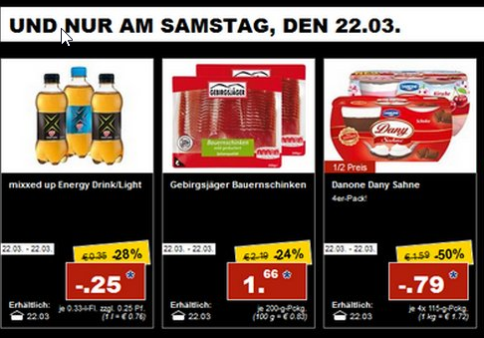

Consider a problem of promotion planning
Application in retail
Planners collect data on their own
Planners have to decide
what,
when,
under what conditions
How much
Experience generates rules

Slide 18
Consider a problem of promotion planning
Application in retail
AI
Counterintuitive results generate mistrust.
Users stop using and rely more on personal intuition.
Experience generates rules

Slide 19
Consider a problem of promotion planning
Application in retail
AI
1.80 < abs_price_diff < 3.11 AND 327.75 < avg_regular_sales < 662.83
expiration_days = 6 AND sale_length_clean = 3 AND 4689.8 < total_regular_revenue < 11219.6
OR
The model predicted 5.48 instead of more than 5.48 because abs_price_diff <= 1.796 and year > 2015
The model predicted 4.54 instead of more than 4.54 because total_regular_revenue > 6129.841 and sale_length > 6.463
Experience generates rules

Slide 20
Consider a problem of promotion planning
Application in retail
Original problem
Regression
Classification
Predict sales during promotions
Predict if sales uplift is greater or less than a median

Slide 21
EXAMPLE
Application in retail
We have to plan a new promotion and would like to see how effective it will be and Why.

Slide 22
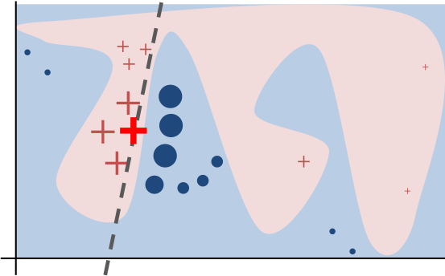
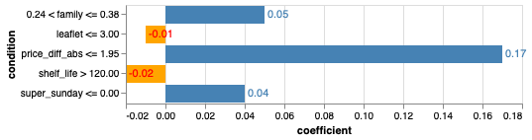
LIME
Emerging approaches
LIME is a local surrogate model
We pick some promotion to classify
The promotion was classified as being over the median
With score 0.96

Slide 23
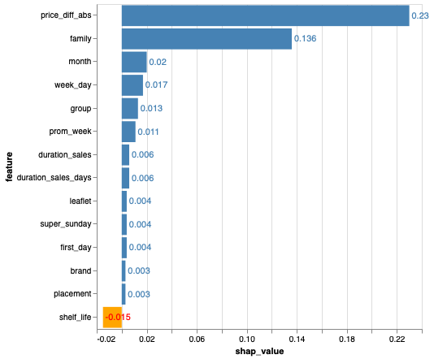
SHAP
Emerging approaches
SHAP value explains the contribution to explain the difference between the average model prediction and the actual prediction of the instance.

Slide 24
Anchor
Emerging approaches
Anchor – local rules with guarantees
price_diff_abs <= 2.00 AND family <= 0.38 AND placement > 0

Slide 25
Counterfactual explanations
Emerging approaches
What minimal changes do we need to introduce to flip the prediction
One can only allow changes to specific features (month, day, store location, etc.)
Sometimes it is not possible to find a counterfactual, especially when model score is close to 1.
A counterfactual:
family: change item family
group: change item group
price_diff_abs: decrease price by 2

Slide 26
Contrastive explanations
Emerging approaches
„Why P rather than Q?“
The model predicted '0' instead of '1' because 'price_diff_abs <= 2.934

Slide 27
Software for Glass Box models
Standard methods like regressions and decision trees are available in sklearn.
Rule list: https://github.com/SeydaErtekin/ORL, https://github.com/nlarusstone/corels, https://github.com/Hongyuy/sbrlmod, https://github.com/cfchen-duke/FRLOptimization, https://github.com/wangtongada/BOA
Rule sets: https://github.com/zli37/bayesianRuleSet, https://pypi.org/project/ruleset/, https://github.com/lvhimabindu/interpretable_decision_sets, https://github.com/jirifilip/pyIDS, https://github.com/wangtongada/MR
Rule generation: https://github.com/meelgroup/mlic
Association rule classification: https://github.com/kliegr/QCBA, https://github.com/kliegr/arcBench

Slide 28
Software for model distillation and visualisation
Model distillation: https://github.com/IBCNServices/GENESIM, https://github.com/sato9hara/defragTrees, https://github.com/andosa/treeinterpreter, https://github.com/timdavidlee/DistillingTree, https://gitlab.com/safrandrti/sirus
Visual analysis: https://github.com/rulematrix/rule-matrix-py, https://github.com/uber/manifold, https://pair-code.github.io/what-if-tool/, https://github.com/nyuvis/explanation_explorer, https://github.com/yosinski/deep-visualization-toolbox, https://github.com/oracle/Skater, https://cran.r-project.org/web/packages/iml/index.html, https://github.com/aaronjfisher/mcr

Slide 29
Software for post-hoc explanations
Prediction explanatioin: https://github.com/marcotcr/lime, https://github.com/slundberg/shap, https://github.com/marcotcr/anchor, https://github.com/AppliedDataSciencePartners/xgboostExplainer, https://github.com/GDPlumb/MAPLE, https://docs.seldon.io/projects/alibi/en/stable/, https://github.com/IBM/AIX360, https://secml.gitlab.io, https://github.com/riccotti/LORE
Counterfactual: https://ceml.readthedocs.io/en/latest/, https://docs.seldon.io/projects/alibi, https://github.com/ClearExplanationsAI/CLEAR, https://github.com/MartinPawel/c-chvae/, https://github.com/amirhk/mace
Contrastive: https://docs.seldon.io/projects/alibi/, https://github.com/MarcelRobeer/ContrastiveExplanation
Influence function: https://github.com/kohpangwei/influence-release

Slide 30
Bonus: image and text explanations
Image: https://github.com/datamllab/xdeep, https://github.com/marcoancona/DeepExplain, https://github.com/albermax/innvestigate, https://github.com/darkonhub/darkon, https://github.com/DanishShah/DeepDiagnosis, https://github.com/tensorflow/tcav/, http://www.heatmapping.org/tutorial/
Text: http://exbert.net, https://captum.ai, https://github.com/fursovia/tcav_nlp, https://github.com/amaiya/ktrain, https://github.com/allenai/allennlp/tree/master/allennlp/interpret, https://github.com/ArrasL/LRP_for_LSTM

Slide 31
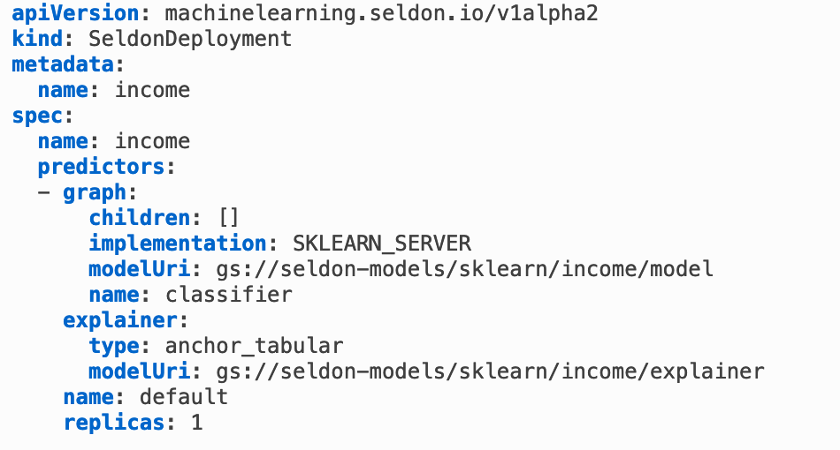

Deployment
Seldon Core. Deployment on Kubernetes.
https://docs.seldon.io/projects/seldon-core/en/v0.5.0/examples/explainer_examples.html

Slide 32



JOIN the club
Collaborate
https://www.linkedin.com/groups/8672810/ - my LinkedIn group Explainable AI –XAI
https://github.com/andreysharapov/xaience - resources on XAI, fairness and more
https://www.xaience.eu/ - my little web page
https://www.aiethicist.org – great resource by Merve Cinarli Hickok

Slide 33
paper references
LIME - https://homes.cs.washington.edu/~marcotcr/blog/lime/
SHAP - https://arxiv.org/abs/1705.07874, https://arxiv.org/abs/2004.00668
MAPLE - https://blog.ml.cmu.edu/2019/07/13/towards-interpretable-tree-ensembles/
LORE - https://arxiv.org/abs/1805.10820
ANCHOR - https://homes.cs.washington.edu/~marcotcr/aaai18.pdf
Counterfactual - https://arxiv.org/abs/1711.00399
Contrastive - http://arxiv.org/abs/1806.07470, https://arxiv.org/abs/1802.07623
Influence function - https://arxiv.org/abs/1703.04730

Slide 34
I invite everyboby to collaborate in the field of explainable AI and algorithmic fairness
Thank you for the time you spend with me

